Slide 1

AI and Machine Learning for IoT Big Data

Slide 2
AI for regression and classification

Slide 3
Outline of the lecture
We learn about using AI technologies for regression and classification in a BD framework.
The specific example is finding the connection between geological, geographical and climate parameters of different regions, and the actual forest observed in the location.
It is important to follow up the lecture with working through the attached notebook.

Slide 4
Outline of the lecture
We learn about using AI technologies for regression and classification in a BD framework.
The specific example is finding the connection between geological, geographical and climate parameters of different regions, and the actual forest observed in the location.
It is important to follow up the lecture with working through the attached notebook.

Slide 5
Where are we in the Course?
Introduction: Background of IoT, Big Data, AI
Collect, analyze data from IoT on a large scale
Elements and practice of statistics
AI methods for data science
Getting further with AI: internal workings
Practical usage of AI for Big Data from IoT
Moving into the real world

Slide 6
AI for regression and classification
Prediction and regression
Regression in statistics
AI for regression: learning a continuous mapping for value prediction
The “servo” example
AI for classification: learning a discrete mapping for classification
The “forest cover” example

Slide 7
The use of prediction
We have observations of “inputs” and “outputs”
We want to find a relationship, giving the mapping from the inputs to outputs
If successful, that mapping will allow predicting outputs corresponding to new, never-seen-before inputs
There is not necessarily a temporal component even when we say “prediction”
Notes:
Expand on the “not necessarily temporal” part: we call it prediction even if it is an already existing parameter.
We “predict” what we will see, it is new to us even if not new in an absolute sense.

Slide 8
Regression vs. classification
If we have continuous outputs, or at least outputs with a range of values, we talk about regression
If the outputs are discrete, most often 0-1 valued, we talk about classification
The two problems are closely related, but it is not trivial to convert a regression problem into classification, or vice versa.
Notes:
Invite students to propose examples of discrete and continuous outputs and inputs.

Slide 9
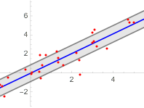
Recall: “Linear Regression”
Notes:
Recall earlier discussions on regression.

Slide 10

An example of regression
“This is an interesting collection of data provided by Karl Ulrich. It covers an extremely non-linear phenomenon - predicting the rise time of a servomechanism in terms of two (continuous) gain settings and two (discrete) choices of mechanical linkages.”
http://www.dcc.fc.up.pt/~ltorgo/Regression/DataSets.html
Notes:
Refer to the “servo.ipynb” Jupyter notebook

Slide 11
The data and the task
We have samples from a servo control experiment: input parameters and output results (a timing, continuous value)
We will try to train an AI system to predict the output from the inputs
Caution: there are very few samples, and the output is strongly non-linear - don’t expect good results…
Notes:
Explain for students without engineering backgrounds the basic concepts:
a servo is a device that you give a target value (setpoint) and it will try to match it with a physical output value (e.g. shaft angle).
servos have many parameters regarding their performance in the time or frequency domain.

Slide 12
Input data
Original form: First two columns are categorical
 | motor | screw | pgain | vgain | class
0 | E | E | 5 | 4 | 0.281251
1 | B | D | 6 | 5 | 0.506252
2 | D | D | 4 | 3 | 0.356251
3 | B | A | 3 | 2 | 5.500033
4 | D | B | 6 | 5 | 0.356251
Notes:
This mechanism has some discrete choices; use the example of shift change in an automobile.

Slide 13
Data ready for Machine Learning
Categorical columns converted to one-hot form (others left in original numerical form):
Table 1
 | pgain | vgain | class | motor_A | motor_B | motor_C | motor_D | motor_E | screw_A | screw_B | screw_C | screw_D | screw_E
0 | 5 | 4 | 0.281251 | 0 | 0 | 0 | 0 | 1 | 0 | 0 | 0 | 0 | 1
1 | 6 | 5 | 0.506252 | 0 | 1 | 0 | 0 | 0 | 0 | 0 | 0 | 1 | 0
2 | 4 | 3 | 0.356251 | 0 | 0 | 0 | 1 | 0 | 0 | 0 | 0 | 1 | 0
3 | 3 | 2 | 5.500033 | 0 | 1 | 0 | 0 | 0 | 1 | 0 | 0 | 0 | 0
4 | 6 | 5 | 0.356251 | 0 | 0 | 0 | 1 | 0 | 0 | 1 | 0 | 0 | 0
Notes:
Why a categorical value is not suitable as direct input to a neural network?

Slide 14
Our approach
Create one-hot representation for the categorical input data
Create a single hidden layer feed-forward neural network, train it on half the data and use the other half for testing
After training, predict the test outputs from the test inputs, and plot the predicted values against the actual outputs
Notes:
Discuss one-hot coding

Slide 15
Result
We were expecting a straight line…
The fit of the predicted and actual values is not good, but neither is it totally wrong
Notes:
Review the data size, why is it too small?

Slide 16
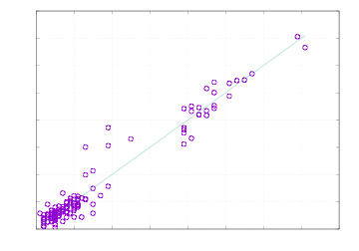
A better result
We try a 16-fold cross validation: divide the dataset into 16 sets of 10 samples each; train with 15 of them and test with the left-out one
The improvement shows that we need more samples!
Notes:
Why does this method help in case of small data size?

Slide 17
Discussion
This example is considered a tough challenge, why?
Look more closely at the data. Is it consistent? Does it have enough information for learning?
How would you step forward with working out a better regression method?
More hidden layers?
Different optimization?

Slide 18
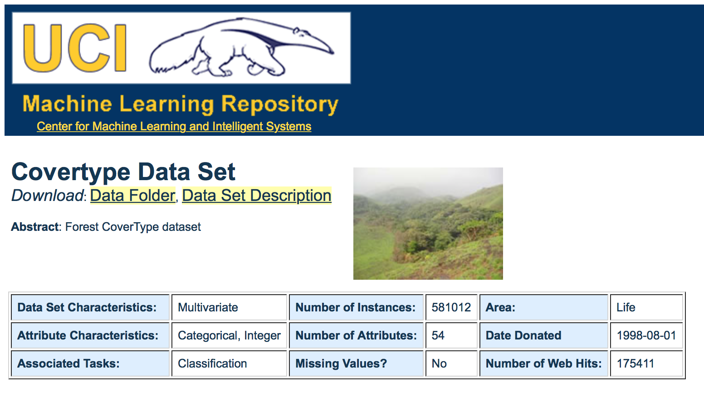
Example: forest covers in different environments
An example of classification
How does the forest depend on: altitude, climate, soil type etc.?
Can we predict the forest that will develop in a given area, from measuring the various environmental conditions?
https://archive.ics.uci.edu/ml/datasets/covertype
Notes:
Review Chapter 4 of the AAS book.

Slide 19
Imports for Spark Machine Learning
import org.apache.spark.ml.{PipelineModel, Pipeline}
import org.apache.spark.ml.classification.{DecisionTreeClassifier,
RandomForestClassifier, RandomForestClassificationModel}
import org.apache.spark.ml.evaluation.MulticlassClassificationEvaluator
import org.apache.spark.ml.feature.{VectorAssembler, VectorIndexer}
import org.apache.spark.ml.linalg.Vector
import org.apache.spark.ml.tuning.{ParamGridBuilder, TrainValidationSplit}
import org.apache.spark.mllib.evaluation.MulticlassMetrics
import org.apache.spark.sql.{DataFrame, SparkSession}
import org.apache.spark.sql.functions._
import scala.util.Random

Slide 20
Open CSV, give name to columns
import spark.implicits._
val dataWithoutHeader = spark.read.
option("inferSchema", true).
option("header", false).
csv("/Users/markon/ITU/covtype.data")
val colNames = Seq(
"Elevation", "Aspect", "Slope",
"Horizontal_Distance_To_Hydrology", "Vertical_Distance_To_Hydrology",
"Horizontal_Distance_To_Roadways",
"Hillshade_9am", "Hillshade_Noon", "Hillshade_3pm",
"Horizontal_Distance_To_Fire_Points"
) ++ (
(0 until 4).map(i => s"Wilderness_Area_$i")
) ++ (
(0 until 40).map(i => s"Soil_Type_$i")
) ++ Seq("Cover_Type")
val data = dataWithoutHeader.toDF(colNames:_*).
withColumn("Cover_Type", $"Cover_Type".cast("double"))
data.show()
data.head
// Split into 90% train (+ CV), 10% test
val Array(trainData, testData) = data.randomSplit(Array(0.9, 0.1))
Notes:
Review the meaning of each instruction (val … = … etc.)

Slide 21
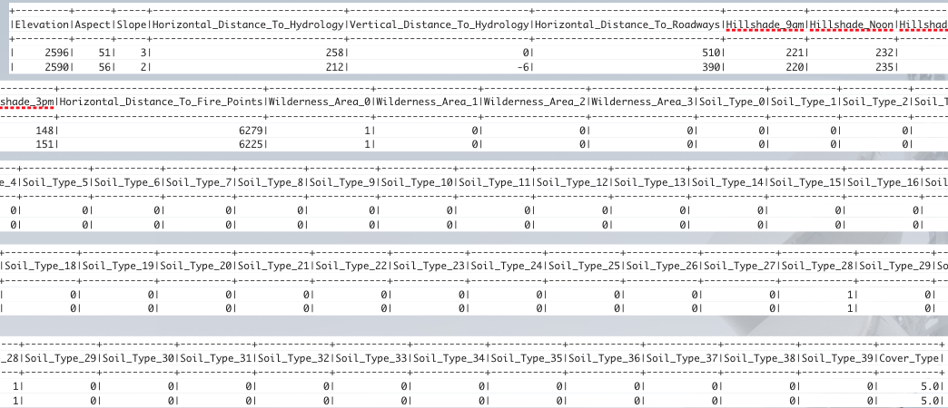
Head of the resulting table
Notes:
The rest of the lecture should be used as a preview of the interactive exercise.

Slide 22
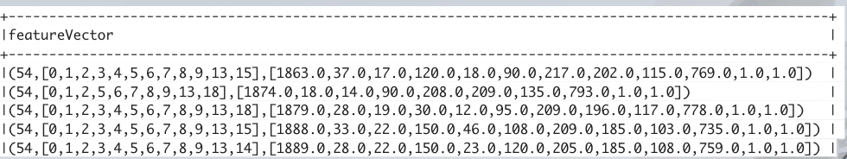
Create a feature vector
val inputCols = trainData.columns.filter(_ != "Cover_Type")
val assembler = new VectorAssembler().
setInputCols(inputCols).
setOutputCol("featureVector")
val assembledTrainData = assembler.transform(trainData)
assembledTrainData.select("featureVector").show(truncate = false)
Notes:
The rest of the lecture should be used as a preview of the interactive exercise.

Slide 23
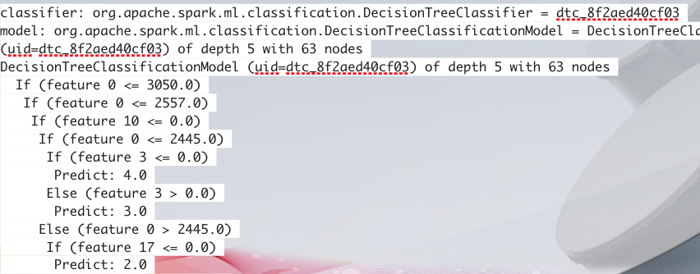
Create a Classifier and train it
val classifier = new DecisionTreeClassifier().
setSeed(Random.nextLong()).
setLabelCol("Cover_Type").
setFeaturesCol("featureVector").
setPredictionCol("prediction")
val model = classifier.fit(assembledTrainData)
println(model.toDebugString)
Notes:
The rest of the lecture should be used as a preview of the interactive exercise.

Slide 24
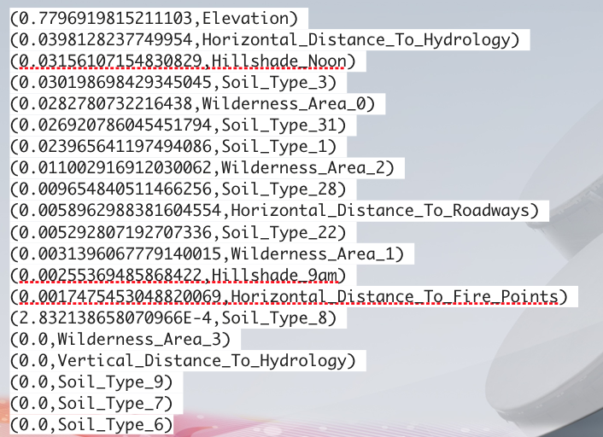
What are the contributions?
model.featureImportances.toArray.zip(inputCols).
sorted.reverse.foreach(println)
Notes:
The rest of the lecture should be used as a preview of the interactive exercise.
Discuss the concept of “contribution”

Slide 25
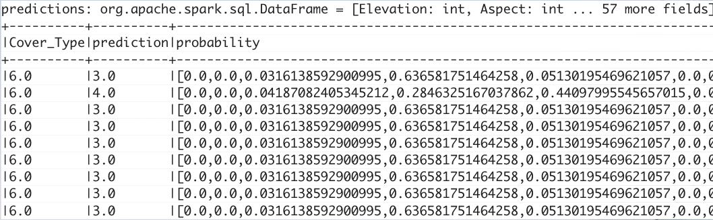
Evaluate the classifier on data
val predictions = model.transform(assembledTrainData)
predictions.select("Cover_Type", "prediction", "probability").
show(truncate = false)

Slide 26
Transfer the classifier to RDD
val evaluator = new MulticlassClassificationEvaluator().
setLabelCol("Cover_Type").
setPredictionCol("prediction")
val accuracy = evaluator.setMetricName("accuracy").evaluate(predictions)
val f1 = evaluator.setMetricName("f1").evaluate(predictions)
println(accuracy)
println(f1)
val predictionRDD = predictions.
select("prediction", "Cover_Type").
as[(Double,Double)].rdd
val multiclassMetrics = new MulticlassMetrics(predictionRDD)
println(multiclassMetrics.confusionMatrix)
Notes:
The unevaluated RDD can work on much bigger datasets too. Discuss the significance!

Slide 27
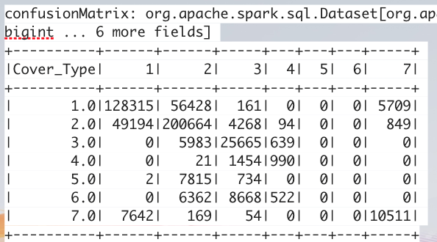
Get the confusion matrix from RDD
val confusionMatrix = predictions.
groupBy("Cover_Type").
pivot("prediction", (1 to 7)).
count().
na.fill(0.0).
orderBy("Cover_Type")
confusionMatrix.show()
Notes:
Using the dataset description, discuss why there is a poor recognition of types 4,5,6?
How it can be improved?

Slide 28
Assignment
Select a sensory dataset with clearly dependent channels (e.g. soil moisture vs. air temperature, sunshine, and rainfall)
Divide the data into segments with low variance within segments
Create a regression analysis with Scala or PySpark
Discuss the results, consider temporal effects

Slide 29
Summary of the lecture
We have learned about using the Spark framework with Scala and its Machine Learning library, to analyze the connection between observed causes (environmental data) and effects (forest cover). We have found that by training a classifier and studying the confusion matrix, we can start learning more about the underlying processes. The techniques of the lecture can be extended to many other cases.

